Slide 1


23rd SG Meeting
South Gas Retional Initiative
Madrid, 5 July 2017

Slide 2
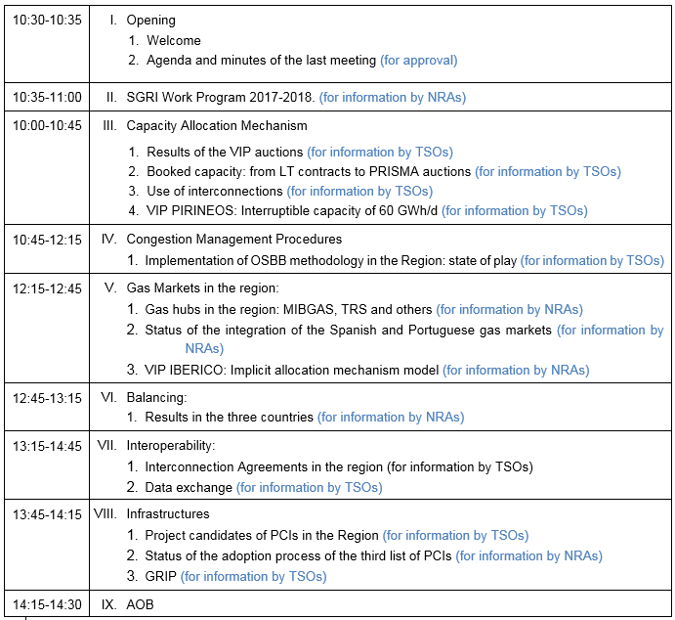
I. Agenda

Slide 3
II. Work Program 2017 - 2018
The main areas of work in Action Plan 2014-2016 were: CAM, CMP, balancing, interoperability and data exchange, infrastructures and hub development. These work areas are also a core part (extended) of the Work Plan 2017-2018.
In addition, the region has decided to work on the assessment of the use of interconnection infrastructures and the functioning of the balancing regimes.
Targets and main areas of work for 2017 – 2018:
    Target 1. Analysis of the use of regional infrastructures
    Target 2. Assessment of the performance of the balancing regimes
    Target 3. Further steps in the market integration
    Target 4. Assessment of the infrastructure investment plans according to regional PCI.
    Target 5. Progress on CMP implementation: OSBB mechanism.

Slide 4
II. Work Program 2017 - 2018
  Target 1. Analysis of the use of regional infrastructures
    To assess the use of interconnections starting from CAM Network Code implementation up to 30 September 2016. The study will address the current situation in the region, its usage, the assessment of the capacity allocated, gas flows and congestions. The analysis will allow proposing recommendations of improvement.
  Target 2. Assessment of the performance of the balancing regimes
    To follow up on the balancing regimes at national level, including: unbalanced volumes, costs, number of TSOs’ balancing actions, and other quantitative variables between 1st October 2016 and 30th September 2017. The analysis will provide new elements in order to evaluate how the different balancing regimes are performing.

Slide 5
II. Work Program 2017 - 2018
  Target 3. Further steps in the market integration
    The third target is twofold. Firstly, to assess the progress of the Spanish-Portuguese market integration towards the Iberian gas market: accommodation of MIBGAS rules, implementation of implicit allocation mechanism, communication procedures and the implementation of the market model.
    At a second stage, to analyse the Iberian and French markets from a regulatory and quantitative perspective. The outcomes of this analysis will shed light on the possible way forward for the project, namely a possible extension to France.

Slide 6
II. Work Program 2017 - 2018
  Target 4. Follow-up of the infrastructure investment plans according to regional PCI
    To participate in interchanging positions about PCIs list, as well as in the elaboration of the regional network plans, since the NRAs’ involvement from the beginning of the process can secure higher coordination and benefits.
  Target 5. Progress on CMP implementation: OSBB mechanism
    To follow up on the progress and performance in the implementation of the OSBB mechanism.

Slide 7
III. Capacity Allocation Mechanisms
III.1 Results of the VIP auctions
III.2 Booked capacity: from LT contracts to PRISMA auctions
III.3 Use of interconnections
III.4 VIP PIRINEOS: Interruptible capacity of 60 GWh/d
(for information by TSOs)
(Introduction by NRAs)

Slide 8
III. Capacity Allocation Mechanisms
  Results of the VIP auctions from Oct. 2015 to Sept. 2016:
  Regarding the direction of the flows the market is mainly interested in flowing gas from France to Spain and from Spain to Portugal.
  There are relevant LT contracts signed prior to CAM NC, valid until 2028 in VIP Pirineos and 2022 in VIP Iberian.
  Due to these LT contracts the technical capacity available to be auctioned in the different time horizons has been quite reduced. In fact, the available auctioned capacities were:
    VIP Pirineos: FR to ES 11%, and ES to FR 21%.
    VIP Ibérico: ES to PT 36%, and PT to ES 100%.

Slide 9
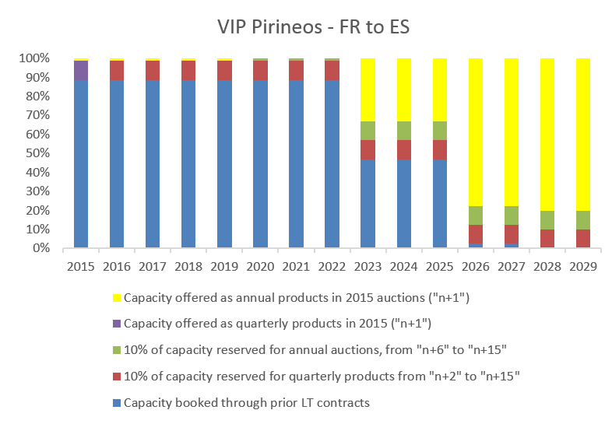
III. Capacity Allocation Mechanisms
  Figure. Booked and available capacities offered at VIP Pirineos before the 2015 annual auction. Source: CNMC

Slide 10
III. Capacity Allocation Mechanisms
  Results of the VIP auctions from Oct 2015 to Sept 2016 (cont.):
  At VIP Pirineos:
    Annual products were auctioned for the next 15 years.
    Concerning annual products, there were only bids for the first year auctioned, which shows a preference for ST capacity, and only 25% of the capacity offered in that year was assigned.
    In the successive auctions of shorter-term products the agents’ interest in acquiring capacity was decreasing.
    In quarterly auctions, only around 2% of the capacity offered was allocated.
    In monthly auctions capacity requests were close to 0% of the capacity offered, except for February and March (8% allocated).
    In daily and intraday auctions, there was generally little participation and the interest in acquiring capacity declined throughout the gas year, (there wasn’t any bid since June 2016).

Slide 11
III. Capacity Allocation Mechanisms
  Results of the VIP auctions from Oct 2015 to Sept 2016 (cont.):
  At VIP Ibérico:
    Annual products were auctioned only for one year.
    Around 50% of the annual capacity product was allocated.
    In quarterly auctions, only an average of 3,5% of the capacity was allocated in the first 3 quarters (0% in the fourth quarter).
    In monthly auctions, around 25% of the capacity was allocated, with a high variability between months, from almost 0% (February to May) to 84% (September).
    In daily and intraday auctions there was in general little participation and the capacity requests were in line with what happened in the monthly auctions: much more interest in September, in which during 23 days 100% of the capacity auctioned was awarded.

Slide 12
III. Capacity Allocation Mechanisms
III.3 Use of interconnections (for information by TSOs)
Assessment of the use of interconnections in the Region from the implementation of the Network Codes: from 1st October 2014 to 30th September 2016.
  Index:
  The current situation of gas interconnections in the Region.
  The use of the gas interconnections.
  Assessment of the capacity allocated since the implementation of the CAM network code.
  Assessment of the gas flows and the congestion status.
  Recommendations.
  Conclusions
  Deliverable Deadline: June 2017

Slide 13
III. Capacity Allocation Mechanisms
III.3 Use of interconnections (for information by TSOs)
The report is aimed to give responses to several questions:
  Can be improved capacity calculation methodology?
  Is it possible to develop a joint dynamic capacity calculation methodology?
  Are agreements to get bundled capacity working?
  Secondary capacity market is working?
  Percentages for short term capacity reservation are working properly?
  What capacity products are more demanded?
  Are there congestions in the region?
  Is CMP working in a coordinated way?
  What CMP mechanism need to be reviewed?
  Which areas need a further coordination/cooperation between TSOs?

Slide 14
III. Capacity Allocation Mechanisms
III.4 VIP PIRINEOS: Interruptible capacity of 60 GWh/d (for information by TSOs)
  From FR to ES direction:
  TIGF offers 60 GWh/d capacity on an interruptible and unbundled basis.
  Since 1st January 2017, ENAGAS offers these 60 GWh/d on a firm and unbundled basis.

Slide 15
IV. Congestion Management Procedures
IV.1 Implementation of OSBB: state of play (for information by TSOs)
  OSBB scheme was approved on April 2016.
  Main principles:
    Offer of additional capacity above the technical values.
    Buy-back of capacity if it is not possible to meet the nominations.
    TSOs have an incentive to offer additional capacity, taking account of the technical conditions.
    The buy-back is a market based procedure.
    Revenues from selling additional capacity and costs arising from the buy-back application are shared between the TSOs.

Slide 16
IV. Congestion Management Procedures
IV.1 Implementation of OSBB: state of play (for information by TSOs)
  Implementation of OSBB mechanism:
    Manual mode: 1st April 2017 (VIP Ibérico)/ 1st October 2017 (VIP Pirineos)
    Fully automatic mode: 1st April 2018
  Description of current application at VIP Ibérico and interim mechanism envisaged at VIP Pirineos
  Ongoing developments to implement OSBB in fully coordinated and automatic mode at both VIPs

Slide 17
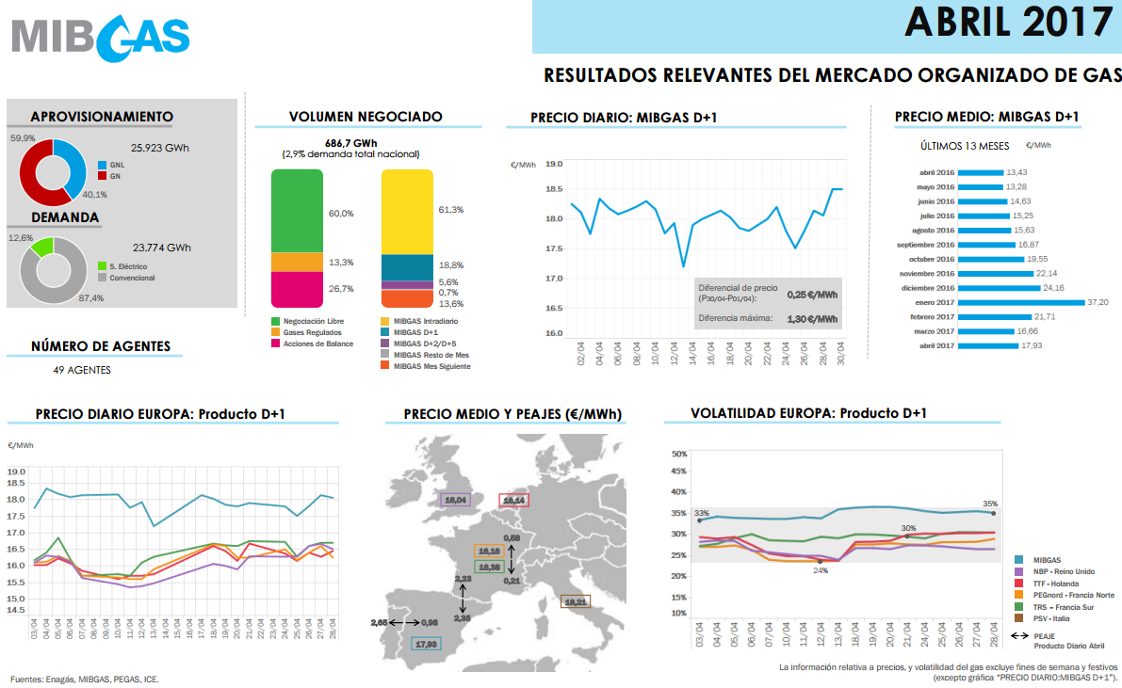
V. Gas markets in the region
V.1 Gas hubs in the region: MIBGAS, TRS and others
(for information by NRAs)

Slide 18
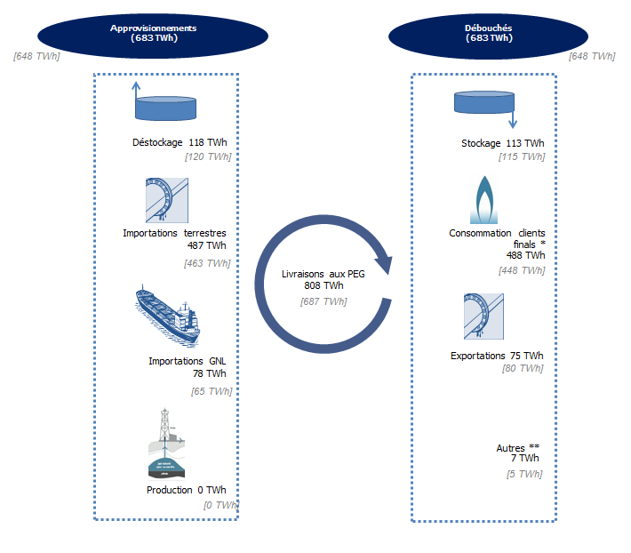
Gas exchanges in France, 2016
In 2016, gas volumes delivered at PEGs amounted to 800 TWh, back to their 2013 level
  PEG Nord: 645 TWh
  PEG TRS: 154 TWh
Average wholesale prices decreased compared to 2015
  PEG Nord: 14.2 €/MWh (vs 20 €/MWh in 2015)
  PEG TRS: 15.5 €/MWh (vs 20.5 €/MWh in 2015)
Spread between PEG Nord and PEG TRS increased during S2 2016

Slide 19
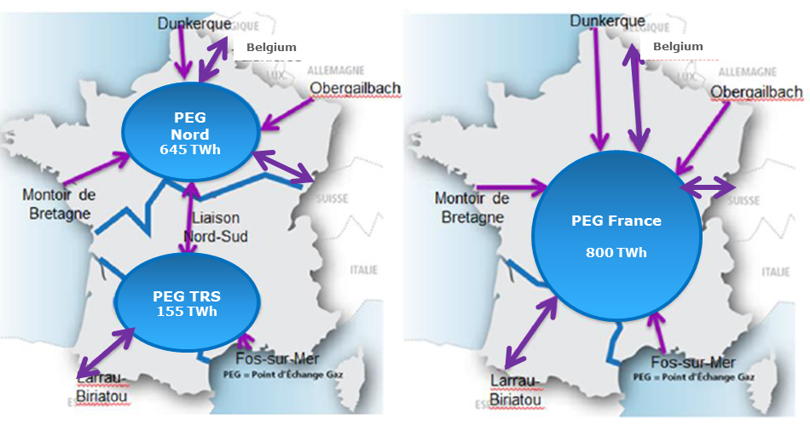
Towards a single market zone in France
The merger of PEG Nord and PEG TRS by end 2018
Objective: develop the liquidity of the PEG and reduce the spreads between the MIBGas/TRS and TTF
Infrastructure developments: Val de Saône and Gascogne-Midi

Slide 20
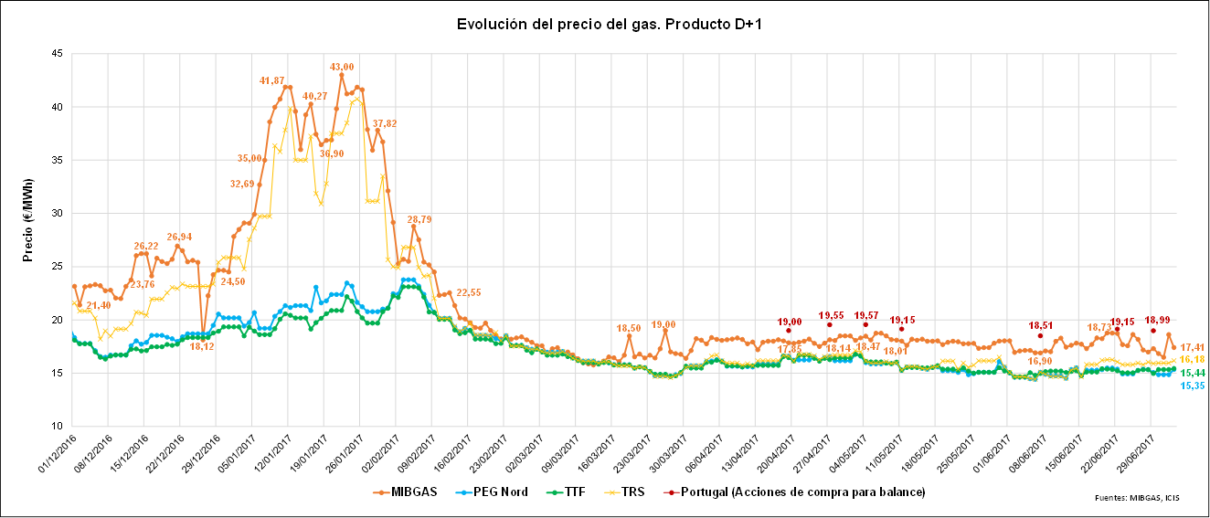
V. Gas markets in the region
V.1 Gas hubs in the region: MIBGAS, TRS and others
(for information by NRAs)
  Evolution of prices D+1 (1st December 2016- 20th June 2017)

Slide 21
V. Gas markets in the region
V.2 Status of the integration of the Spanish and Portuguese markets (for information by NRAs)
V.3 VIP IBERICO. Implicit allocation mechanism model.
(for information by NRAs)
  Implicit allocation mechanism agreed between Spain and Portugal.
  ERSE has held a public consultation on the “Procedimento 13 - mecanismo para atribuição implícita de capacidade do VIP no MIBGAS”.
  CNMC has recently launched a public consultation and on a new regulation (Circular) implementing the implicit allocation mechanism.

Slide 22
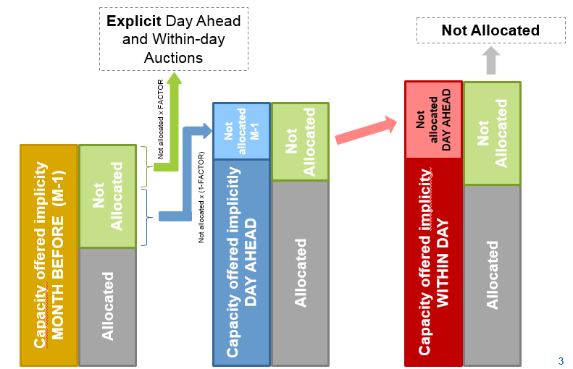
V. Gas markets in the region
  Implicit allocation process:

Slide 23
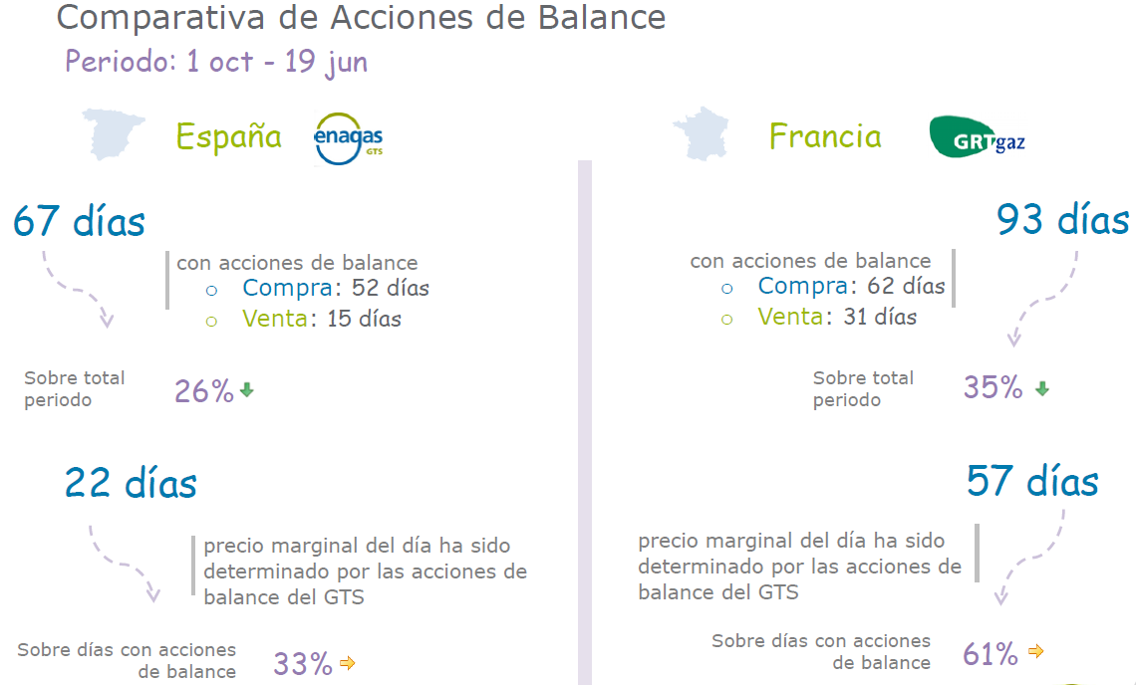
VI. Balancing
VI.1 Results in the three countries (for information by NRAs)

Slide 24
VI. Balancing
VI.1 Results in the three countries (for information by NRAs)
  Index of the report:
  Subject matter. Brief description of the objective and scope of the study. (drafter: NRAs)
  Description of the balancing regimes in place (France, Spain and Portugal). (drafter: NRAs)
  Follow-up of the functioning of the balancing schemes since its application (1st October 2015 in France and 1st October 2016 in Portugal and Spain) to 30th September 2017. (drafter: TSOs)
  Conclusions and recommendations. (drafter: TSOs, NRAs)
  Deadline: February 2018

Slide 25
VII. Interoperability
VII.1 Interconnection Agreements (IA) in the region
VII.2 Data exchange
(for information by TSOs)

Slide 26
VIII. Infrastructures
VIII.1 Project candidates – PCIs in the region (for information by TSOs)
VIII.2 Status of the adoption process of the 3rd list of PCIs
(for information by NRAs)
VIII.3 GRIP (for information by TSOs)

Slide 27
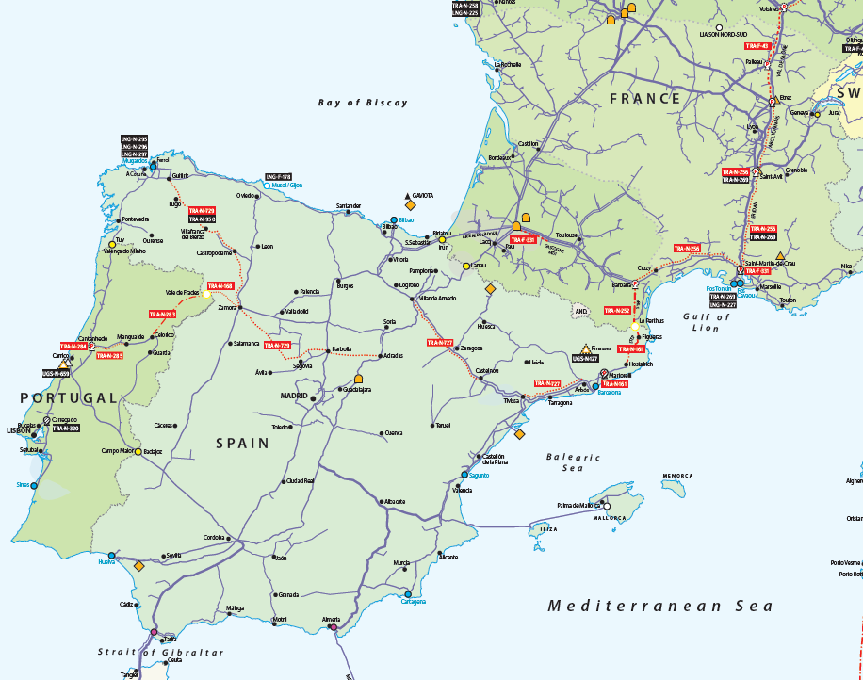
VIII. Infrastructures
3ª IP Pt-ES
MidCat
Proceso PCI
De acuerdo con el Reglamento 347/2013, el proceso PCI se repite cada dos años, y se seleccionan aquellos proyectos que son de interés para el conjunto de Europa. La última lista PCI
Los proyectos candidatos a ser seleccionados como PCI tienen que estar incluidos obligatoriamente en el último TYNDP en vigor.
Enagás tiene 2 PCIs
  MidCat
  3ª IP ES-PT.
STEP

Slide 28
IX. AOB
Any Other Business…

Slide 29

Thank you for your attention!
www.acer.europa.eu
TAR TF Telco
Ljubljana, 14 June2017

